Slide 1
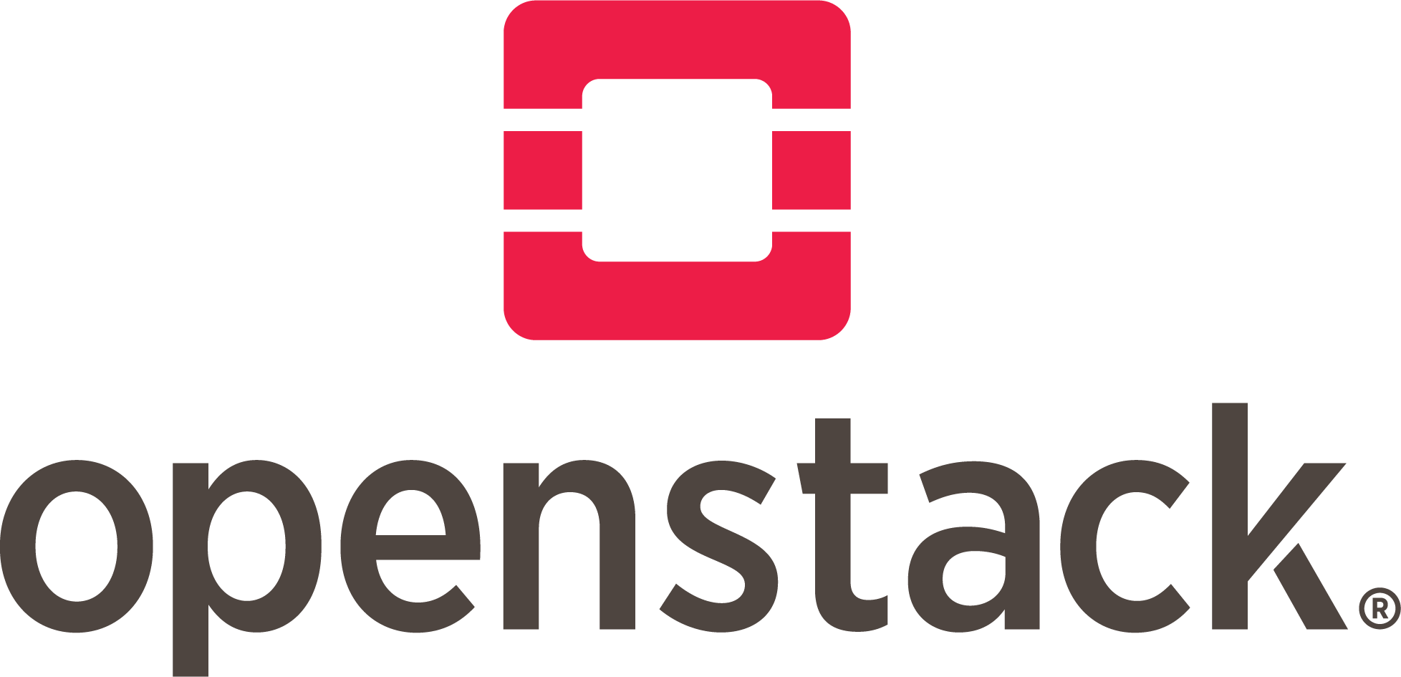
The Most Widely Deployed Open Source Cloud Software in the World

Slide 2
Openstack
Openstack is a cloud service which offers primarily IaaS to users
It is piece of software when installed on cluster of Physical machines , offers the users to create , run and manage VMs on top of it along with support to attach the connected storage along with networking services in a virtual format known as IaaS

Slide 3
Basic Principles of OpenStack
Open Source: Under the Apache 2.0 license, OpenStack is coded and published. Apache allows the community to use it for free.
Open Design: For the forthcoming update, the development group holds a Design Summit every 6 months.
Open Development: The developers maintain a source code repository that is freely accessible through projects like the Ubuntu Linux distribution
Open Community: OpenStack allows open and transparent documentation for the community.

Slide 4
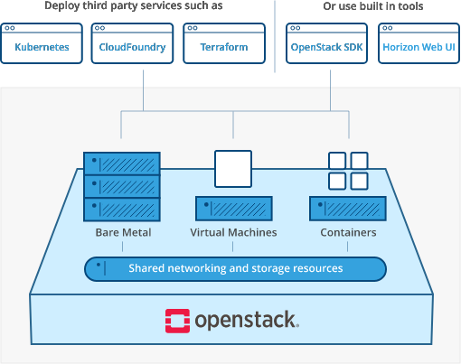

Slide 5
History
2010: OpenStack Started as joint project of Rackspace Hosting & NASA
2012: Nasa Withdraw Openstack Project and adapted AWS.
Redhat entered Openstack Project
Openstack Foundation, a non-profit corporate entity established
2013: Oracle joined as sponsor
2015: NASA still uses openstack private cloud as user
2017: More than 500 companies had joined this project
2020: renamed to Open Infrastructure Foundation from 2021

Slide 6
Open Stack Releases
Openstack release cycle is every 6 month
Release name are based on Alphabets (A...XY,Z)
Austin 21 October 2010
Juno 16 October 2014 (first enterprise software)
Pike 30 August 2017
Queens 28 February 2018
Ussuri 13 May 2020
Victoria 14 October 2020
Wallaby 14 April 2021
Xena 06 October 2021
Zed 05 December 2022 (upcoming release)

Slide 7
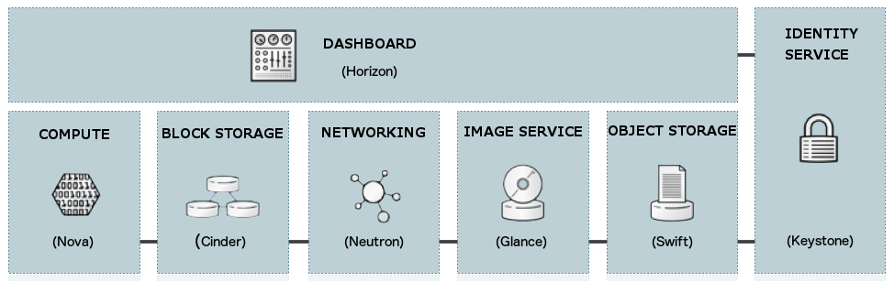
Open Stack Services

Slide 8
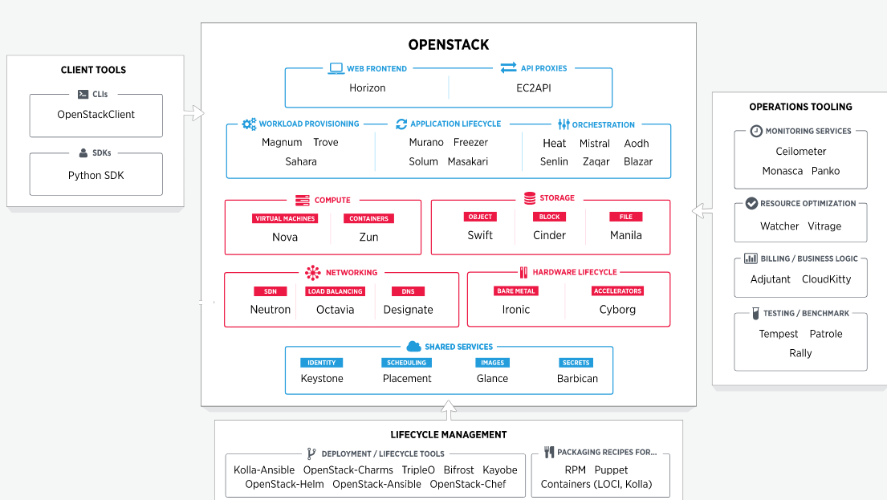

Slide 9
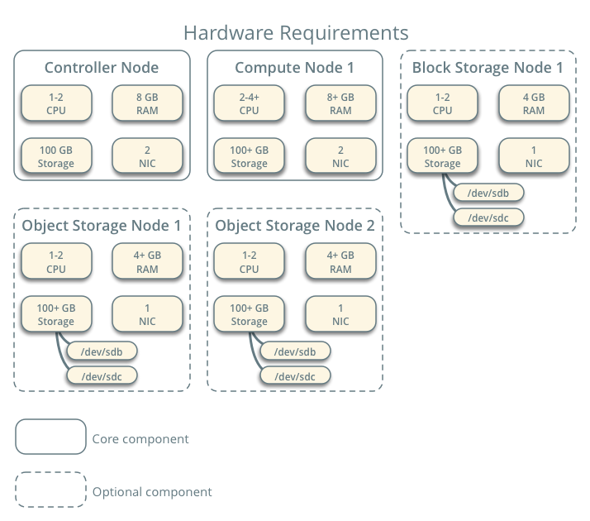
Hardware Requirements
Controller Node: Controls complete architecture of the solution
Compute Node: Runs Virtual Machine
Block Storage Node: Provide Block Storage Service
Object Storage Node: Provide object Storage Service

Slide 10
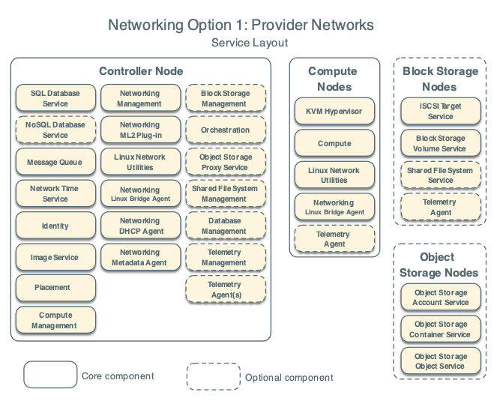
Service Layout

Slide 11
Nova (Compute Service)
First Appeared in Austin Release
Nova is the Openstack project that provides a way to provision compute instances
Nova supports creating virtual machines , baremetal servers (through use of ironic) and has limited support for system containers
Nova runs a set of daemons on top of existing Linux servers to provide that service

Slide 12

Nova (Compute Service)
It require following additional Openstack services for basic function
Keystone: This provides identity and authentication for all OpenStack services.
Glance: This provides the compute image repository. All compute instances launch from glance images.
Neutron: This is responsible for provisioning the virtual or physical networks that compute instances connect to
Placement: This is responsible for tracking inventory of resources available in a cloud and assisting in choosing which provider of those resources will be used when creating a virtual machine.

Slide 13
OpenStack Compute consists of the following areas and their components:
nova-api service: Accepts and responds to end user compute API calls
nova-api-metadata service: Accepts metadata requests from instances
nova-compute service: worker daemon to talk with hypervisor.
nova-scheduler service : decides compute host
nova-conductor module : Mediates interactions between nova-compute service & DB
nova-novncproxy daemon : Proxy to access VM Console GUI via VNC
nova-spicehtml5proxy daemon :Proxy to access VM Console GUI via SPICEHTML
The queue : Central Hub for passing messages between daemons (RabbitMQ)
SQL database : OpenStack Compute can support any database that SQLAIchemy supports
SQLite3 for Research and Development work
MySQL, MariaDB for commercial setup

Slide 14
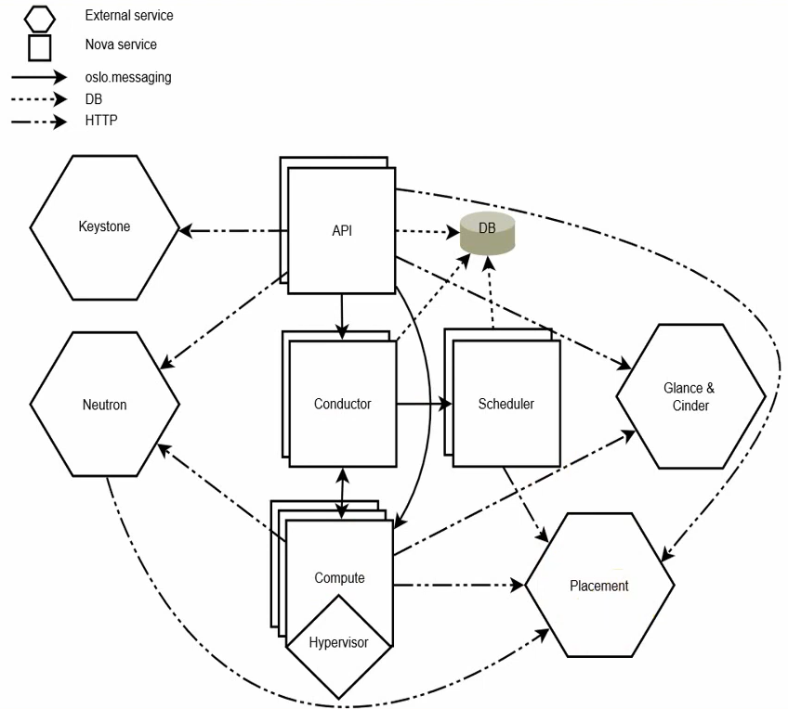
Nova System Architecture
DB: sql database for data storage.
API: component that receives HTTP requests, converts commands and communicates with other components via the oslo.messaging queue or HTTP.
Scheduler: decides which host gets each instance.
Compute: manages communication with hypervisor and virtual machines.
Conductor: handles requests that need coordination (build/resize), acts as a database proxy, or handles object conversions.
Placement: tracks resource provider inventories and usages.

Slide 15
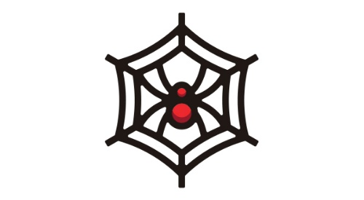
Neutron (Networking)
First Appeared in Folsom release
Neutron is focused on delivering networking as a service in virtual compute environment
It enables to create advanced virtual network topologies which may include services such as firewall and vpn
It also supports security groups to block or unblock ports , port ranges or traffic types for that VM
It require following additional Openstack service for basic function
1.Keystone

Slide 16

Keystone(Identity Service)
First appeared in Essex release
API client authentication, service discovery and distributed multi-tenant authorization by implementing Openstack identity API
Keystone is organized as group of internal services exposed on one or many endpoints
For example: an authenticate call will validate user/project credentials with the identity service and upon success create and return a token
It require no additional Openstack service for basic function

Slide 17

Glance (Image Service)
First appeared in Bexar Release
Glance image services include discovering , registering and retrieving virtual machines images
Glance has a Restful API that allow querying of VM image metadata as well as retrieval of the actual image
VM images made available through Glance can be stored in a variety of locations from simple file systems to object storage system
It require following additional Openstack service for basic function
1.Keystone

Slide 18

Horizon (GUI Service)
First appeared in Essex Release
This is the first component that the user sees in the OpenStack.
Horizon is the web UI (user interface) component used to access the other back-end services.
Through individual API (Application programming interface), developers can access the OpenStack's components, but through the dashboard, system administrators can look at what is going on in the cloud and manage it as per their need.
It require following additional Openstack service for basic function
1.Keystone

Slide 19

Swift (Object Storage)
First appeared in Austin Release
Swift is a highly available, distributed, eventually consistent object storage.
Organizations can use Swift to store lots of data efficiently, safely, and cheaply
Swift is ideal for unstructured data
It require following additional Openstack service for basic function
1.Keystone

Slide 20
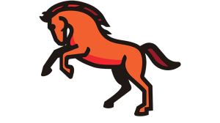
Cinder (block storage)
First appeared in Folsom Release
Cinder is a Block Storage service for OpenStack.
It virtualizes the management of block storage devices and provides end users with a self service API to request and consume those resources without requiring any knowledge of where their storage is actually deployed or on what type of device.
This is done through the use of either a reference implementation (LVM) or plugin drivers for other storage
It require following additional Openstack service for basic function
1.Keystone

Slide 21
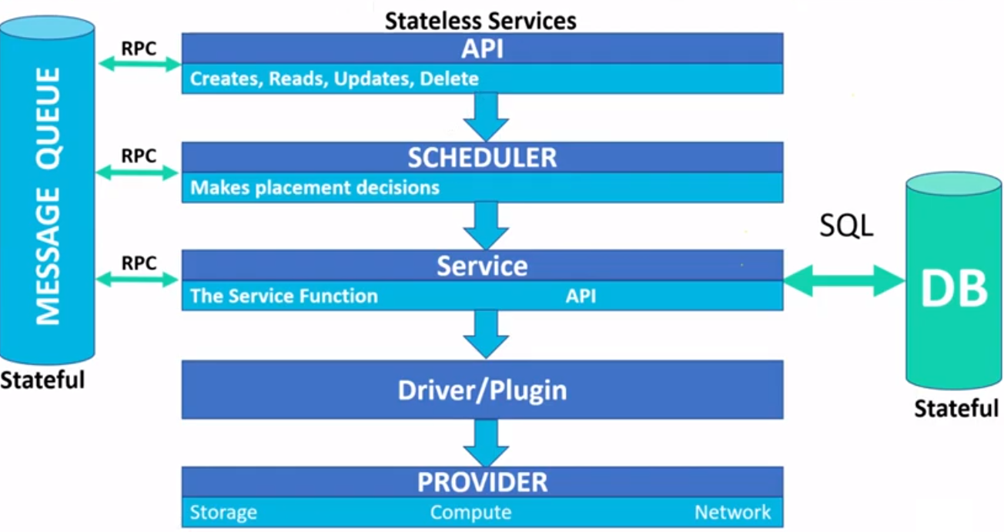

Slide 22
OpenStack vs. AWS
OpenStack and AWS are both cloud computing platforms. Both serve different purposes.
The AWS got introduced in 2006. And since 2006, the success of AWS has been rising rapidly.
Similarly, OpenStack had also grown since its beginning in 2010.

Slide 23
AWS
AWS (Amazon Web Services) is an on-demand cloud computing platform
AWS offers a processing unit, storage, Big Data platform, ML platform, etc
Since AWS is an on-demand platform, It follows the concept of pay-as-you-go, you just pay for the things you are using.
Unlike OpenStack, AWS is not an open-source platform. Only as a user we can use it

Slide 24
OpenStack
OpenStack is an open-source platform. Using OpenStack, we can create our own cloud and configure the things as per our needs
We can deploy OpenStack in both private and public networks. Users can access the OpenStack via a web-based dashboard component or APIs

Slide 25
Who uses OpenStack?
There are thousands of OpenStack users across a broad range of industries.

Slide 26

In 2022, Nayatel — one of Pakistan’s leading telecom providers — announced that it completed the deployment of Pakistan’s first local public cloud. Aiming to meet the demand for a homegrown public cloud service, Nayatel partnered with Canonical to build an enterprise-grade OpenStack platform.

Slide 27

In 2022, Pacific Textiles Holdings Limited — one of the world’s largest fabric mills — announced that it’s going to use Canonical’s Charmed OpenStack and Charmed Kubernetes to give its developers easy access to technologies like cloud-native apps, Kubernetes, AI/ML, and others alike.

